Slide 1



LOGO
AI-Driven Innovations to Enhance Tea Production and Quality in Sri Lanka’s
Mid-Country
PROJECT ID • 25-26J-133
1
25-26J-133​ 01
Notes:
[Sources] - AI-generated background (no external source). [/Sources]

Slide 2

Problem Definition
The Sri Lankan tea industry, though vital to the economy, struggles with productivity, quality, and sustainability. Farmers face inconsistent plucking, quality loss, and undetected disease and pest outbreaks, while factories and auction stakeholders depend on manual grading, limited forecasting, and inefficient planning, leading to reduced competitiveness.
PROJECT ID • 25-26J-XXX
25-26J-133
3
02
Notes:
[Sources] - AI-generated background (no external source). [/Sources]

Slide 3
Main components
1.AUTOMATED FRESHNESS GRADING SYSTEM ANDTEA TYPE CLASSIFICATION
2.PREDICTIVE ANALYTICS FOR TEA CROP YIELD MANAGEMENT
3.TEA MARKET DEMAND FORECASTING AND SMART AUCTION PLANNING
4.AI BASED TEA LEAF DISEASE DETECTION AND TREATMENT GUIDANCE
PROJECT ID • 25-26J-XXX
25-26J-133
3
03
Notes:
[Sources] - AI-generated background (no external source). [/Sources]

Slide 4

AUTOMATED FRESHNESS GRADING SYSTEM AND TEA TYPE CLASSIFICATION
ABEYSEKARA A.M.N - IT22154576
PROJECT ID • 25-26J-XXX
A.M.N Abeysekara| IT22154576| 25-26J-133
1
04
Notes:
[Sources] - AI-generated background (no external source). [/Sources]

Slide 5
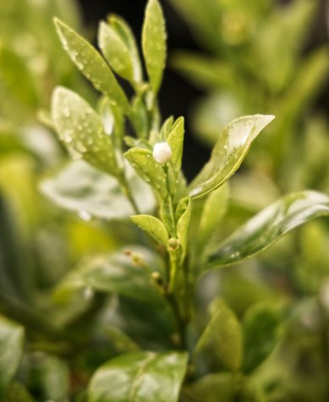
Problem Definition
Manual tea quality assessment is subjective, slow, and inconsistent
Current ML research focuses on disease detection, not production quality
Inconsistent manual grading can lead to disputes and unfair compensation
PROJECT ID • 25-26J-XXX
A.M.N Abeysekara| IT22154576| 25-26J-133
2
05
Notes:
[Sources] - https://images.unsplash.com/photo-1582016448076-551e264dd1e3 (tea leaf photo, Unsplash). [/Sources]

Slide 6
Solution: How It Addresses the Problems
1. Image Capture App:
TeaVision mobile app with real-time quality validation detects blur, exposure issues, and glare to ensure research-grade image capture
2. Quality Classification + Advisory:
Hybrid ML system: Classical pipeline (96.36% accuracy) for 5-class quality grading + RAG-based advisory using TRI published documents
3. Cultivar Identification:
Tea cultivar identification system for variety classification(future work)
PROJECT ID • 25-26J-XXX
A.M.N Abeysekara| IT22154576| 25-26J-133
3
06
Notes:
[Sources] - AI-generated background (no external source). [/Sources]

Slide 7
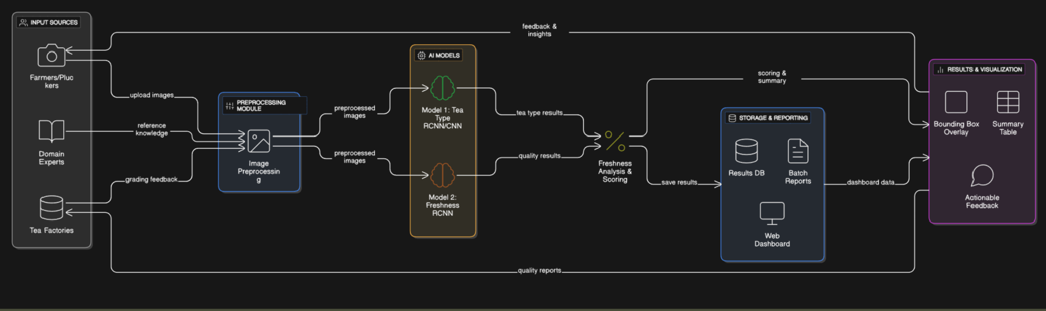
SYSTEM DIAGRAM
PROJECT ID • 25-26J-XXX
A.M.N Abeysekara| IT22154576| 25-26J-133
6
07
Notes:
[Sources] - No external sources. [/Sources]

Slide 8
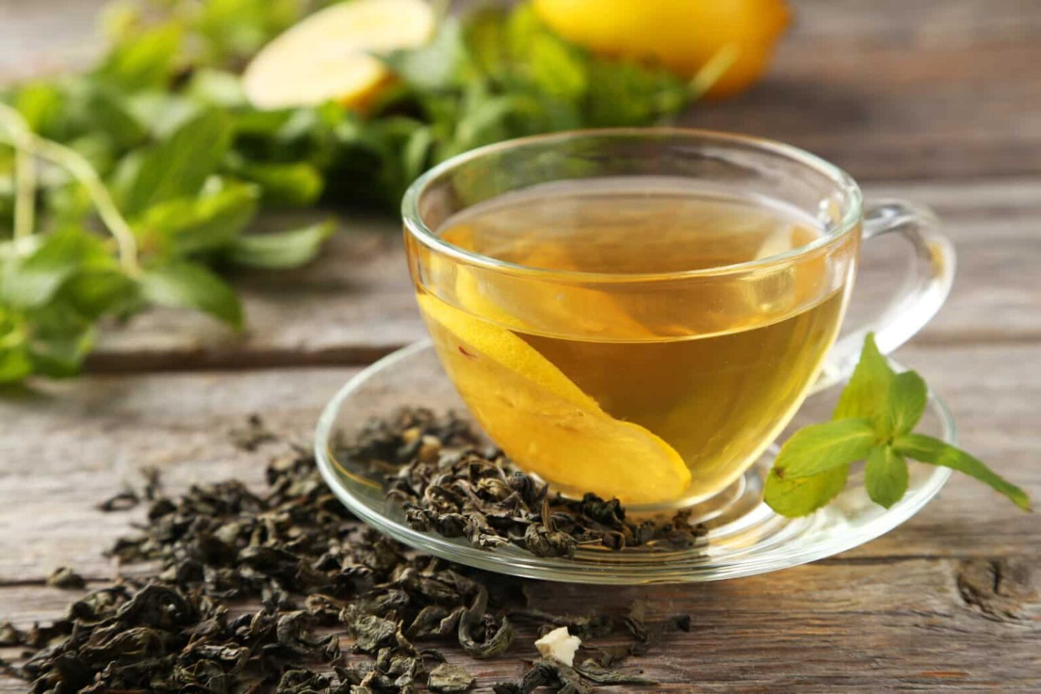
TECHNIQUES
Image Capture & Validation:
Technologies: Kotlin, Android SDK, CameraX
Quality Validation: Real-time blur detection, exposure checking, glare detection
Metadata: Session-based capture with timestamp and device info
Output: Research-grade images for ML training
Tea Leaf Quality Classification:
Feature Engineering: 25 hand-crafted features
Color: RGB, HSV, LAB (lab_a_mean, lab_b_mean, green_ratio, browning_ratio)
Shape: solidity, eccentricity, area_ratio, aspect_ratio
Texture: GLCM correlation, LBP energy, LBP std
Technologies: Python, OpenCV, scikit-learn
Models: AdaBoost, Random Forest, Gradient Boosting, SVM, KNN, MLP
Best Model: AdaBoost 96.36% accuracy, Macro F1: 0.964
Split Strategy: Session-based splitting (prevent data leakage)
PROJECT ID • 25-26J-XXX
A.M.N Abeysekara| IT22154576| 25-26J-133
4
08
Notes:
[Sources] - https://images.unsplash.com/photo-1582016448076-551e264dd1e3 (tea leaf photo, Unsplash). [/Sources]

Slide 9
TECHNIQUES
Object Detection (In Progress):
Technologies: YOLOv8, Ultralytics, Roboflow
Task: Multi-class leaf detection with bounding boxes
Current Performance: 56.9% mAP50
RAG Advisory System:
Technologies: Python, Sentence-BERT, FAISS, LangChain
Chunking: 51 words per chunk average
Retrieval: Hybrid (Dense + BM25 fusion)
Corpus: TRI published documents (14 categories)
Performance: MRR=1.0, Recall@5=100%, Hit Rate@5=100%
PROJECT ID • 25-26J-XXX
A.M.N Abeysekara| IT22154576| 25-26J-133
4
09
Notes:
[Sources] - https://images.unsplash.com/photo-1582016448076-551e264dd1e3 (tea leaf photo, Unsplash). [/Sources]

Slide 10
OVERVIEW
Current Enhancement Methods
1
Tea Leaf Image Capture & Validation
TeaVision mobile app (Kotlin) with real-time blur, exposure, and glare detection for research-grade image collection.
2
Multi-Class Quality Classification
25 hand-crafted features (color, shape, texture) classified using AdaBoost — 96.36% accuracy with session-based splitting.
3
Monthly Yield Forecasting
Hybrid retrieval (Sentence-BERT + BM25) over TRI documents using FAISS — MRR: 1.0, Recall@5: 100%.
A.M.N Abeysekara| IT22154576| 25-26J-133
10
Notes:
[Sources] - AI-generated background (no external source). [/Sources]

Slide 11
OVERVIEW
Future Enhancement Methods
1.Improved Detection Accuracy: Expand dataset (800-1000 images) and refine YOLO training to improve mAP50 beyond 56.9%
2. Mobile Deployment: Export model to TFLite for real-time on-device inference without internet.
3. Rigorous RAG Evaluation: Create larger test set (50+ queries) with hard negatives for robust validation.
4.Unified System Integration: Integrate capture, classification, and advisory modules into single end-to-end mobile application..
A.M.N Abeysekara| IT22154576| 25-26J-133
11
Notes:
[Sources] - AI-generated background (no external source). [/Sources]

Slide 12

PREDICTIVE ANALYTICS FOR TEA CROP YIELD MANAGEMENT
WADUTHANTHRI W.T.H.D - IT22222268
PROJECT ID • 25-26J-XXX
W.T.H.D Waduthanthri| IT22222268 | 25-26J-133
1
12
Notes:
[Sources] - AI-generated background (no external source). [/Sources]

Slide 13
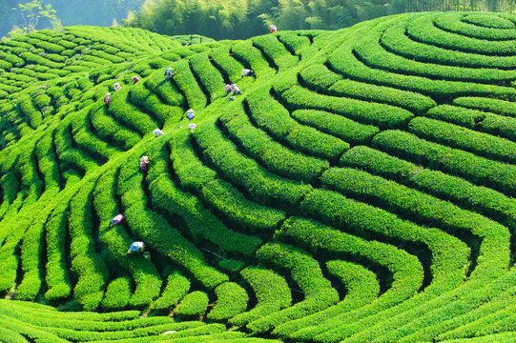
Problem Definition
Data Digitization Gap: Most Sri Lankan tea estates still record yield data manually in log books, making information storage prone to physical damage, loss, and inconsistency.
Lack of Standard Framework: There is no established system or framework for scanning, processing, and converting handwritten yield records into analyzable digital formats.
​
Barrier to Predictive Analytics: The absence of digitized and structured yield data restricts the development of reliable forecasting models and decision-support tools for the tea industry.​
​
PROJECT ID • 25-26J-XXX
W.T.H.D Waduthanthri| IT22222268 | 25-26J-133
2
13
Notes:
[Sources] - https://images.unsplash.com/photo-1582016448076-551e264dd1e3 (tea leaf photo, Unsplash). [/Sources]

Slide 14
Solution: How It Addresses the Problems
Tea yield book digitization Module-Manual estate yield log books are scanned and converted into structured digital datasets, reducing data loss and enabling centralized analysis across years.
Agronomic & Cyclic Yield Forecasting- Introduces estate-level monthly and yearly yield prediction models using historical, agronomic, and crop cycle data.
Introduce potential yield estimation module for data-driven targets.
PROJECT ID • 25-26J-XXX
W.T.H.D Waduthanthri| IT22222268 | 25-26J-133
3
14
Notes:
[Sources] - AI-generated background (no external source). [/Sources]

Slide 15
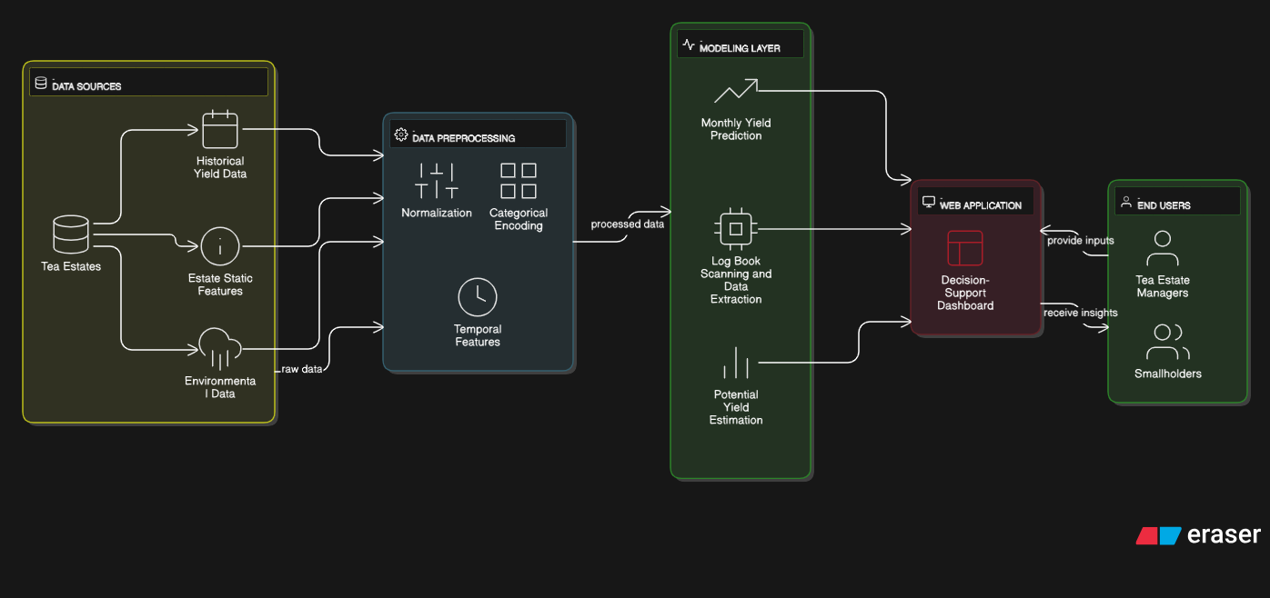
SYSTEM DIAGRAM
PROJECT ID • 25-26J-XXX
W.T.H.D Waduthanthri| IT22222268 | 25-26J-133
6
15
Notes:
[Sources] - No external sources. [/Sources]

Slide 16
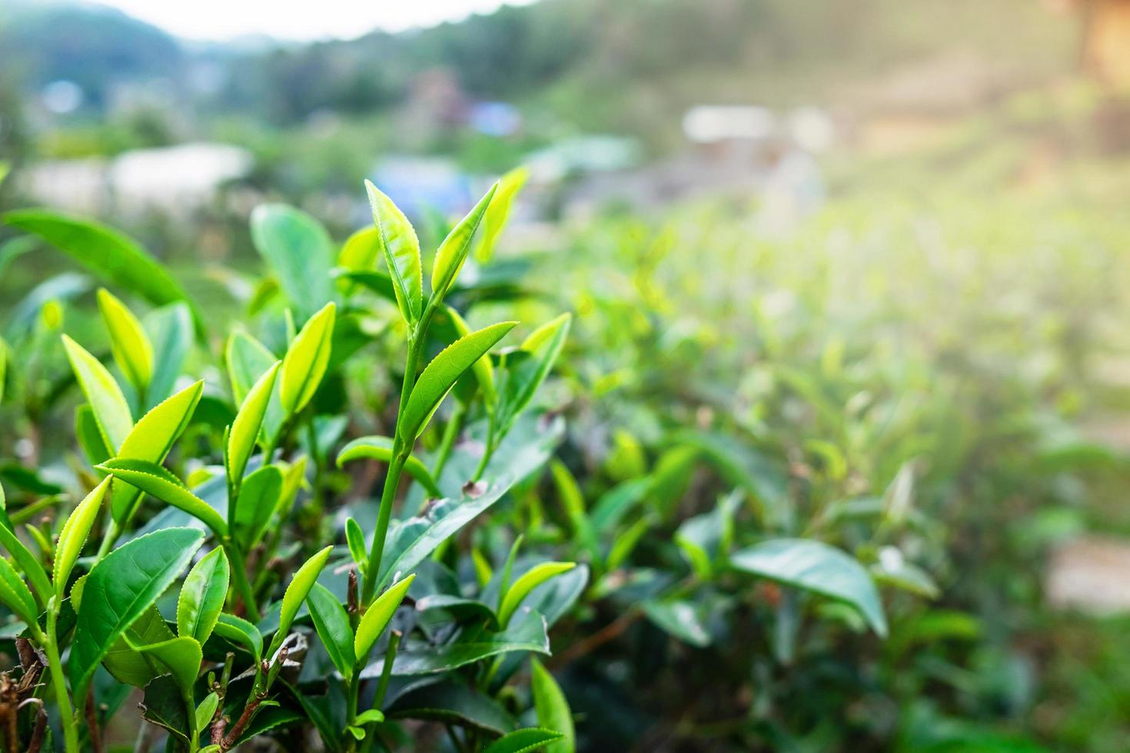
TECHNIQUES
Yield Log book Scanning :
Technologies: Python, OpenCV, PaddleOCR, OpenPyXL
Image Processing: Document rectification, table detection, grid extraction,line removal
Text Extraction: Deep learning–based OCR for handwritten and printed text
Post-Processing: Cell mapping, column type detection, data cleaning and normalization
Output Format: Structured Excel datasets for analysis
Agronomic & Cyclic Yield Forecasting:
Data Cleaning: Cleaning digitized yield data by handling missing values, correcting inconsistencies, and removing noise.
Feature Engineering: Creation of rolling features and lag features to capture temporal, agronomic, and cyclic yield patterns.
Models: Gradient Boosting and LightGBM models for monthly and yearly tea
yield prediction.
Hyperparameter Tuning: Optimization of model parameters to improve yield prediction accuracy and modelstability.
PROJECT ID • 25-26J-XXX
W.T.H.D Waduthanthri| IT22222268 | 25-26J-133
4
16
Notes:
[Sources] - https://images.unsplash.com/photo-1582016448076-551e264dd1e3 (tea leaf photo, Unsplash). [/Sources]

Slide 17
OVERVIEW
Current Enhancement Methods
1
Yield Log Book Digitization: Handwritten tea yield log book images were digitized using image processing techniques, including document rectification, table detection, and grid extraction, together with deep learning–based OCR for text extraction.
2
Data Structuring and Post-Processing
The extracted text was mapped to corresponding table cells, relevant column types were identified, and the data was cleaned and normalized
3
Monthly Yield Forecasting
Monthly tea yield forecasting was performed using historical yield data and engineered temporal features to support data-driven planning.
W.T.H.D Waduthanthri| IT22222268 | 25-26J-133
17
Notes:
[Sources] - AI-generated background (no external source). [/Sources]

Slide 18
OVERVIEW
Future Enhancement Methods
1.Improved Data Extraction Accuracy: Future work will focus on further refining image preprocessing and OCR techniques to enhance the accuracy and robustness of yield data extraction from log book images.
2. Potential Yield Forecasting: The forecasting framework can be extended to estimate potential tea yield beyond historical trends, enabling data-driven target setting and long-term planning.
3. Extend yield forecasting to yearly prediction and develop a mobile application for decision support.
4.Unified System Integration: All developed modules, including yield log book digitization, and yield forecasting, can be integrated into a single unified system to provide an end-to-end decision-support platform for tea estate management.
W.T.H.D Waduthanthri| IT22222268 | 25-26J-133
18
Notes:
[Sources] - AI-generated background (no external source). [/Sources]

Slide 19

LOGO
Tea Market Demand Forecasting and Smart Auction Planning
BANDARANAYAKE B.G.W.T.N. | IT22247018
PROJECT ID • 25-26J-XXX
B.G.W.T.N. Bandaranayake | IT22247018 | 25-26J-133
19
Notes:
[Sources] - AI-generated background (no external source). [/Sources]

Slide 20
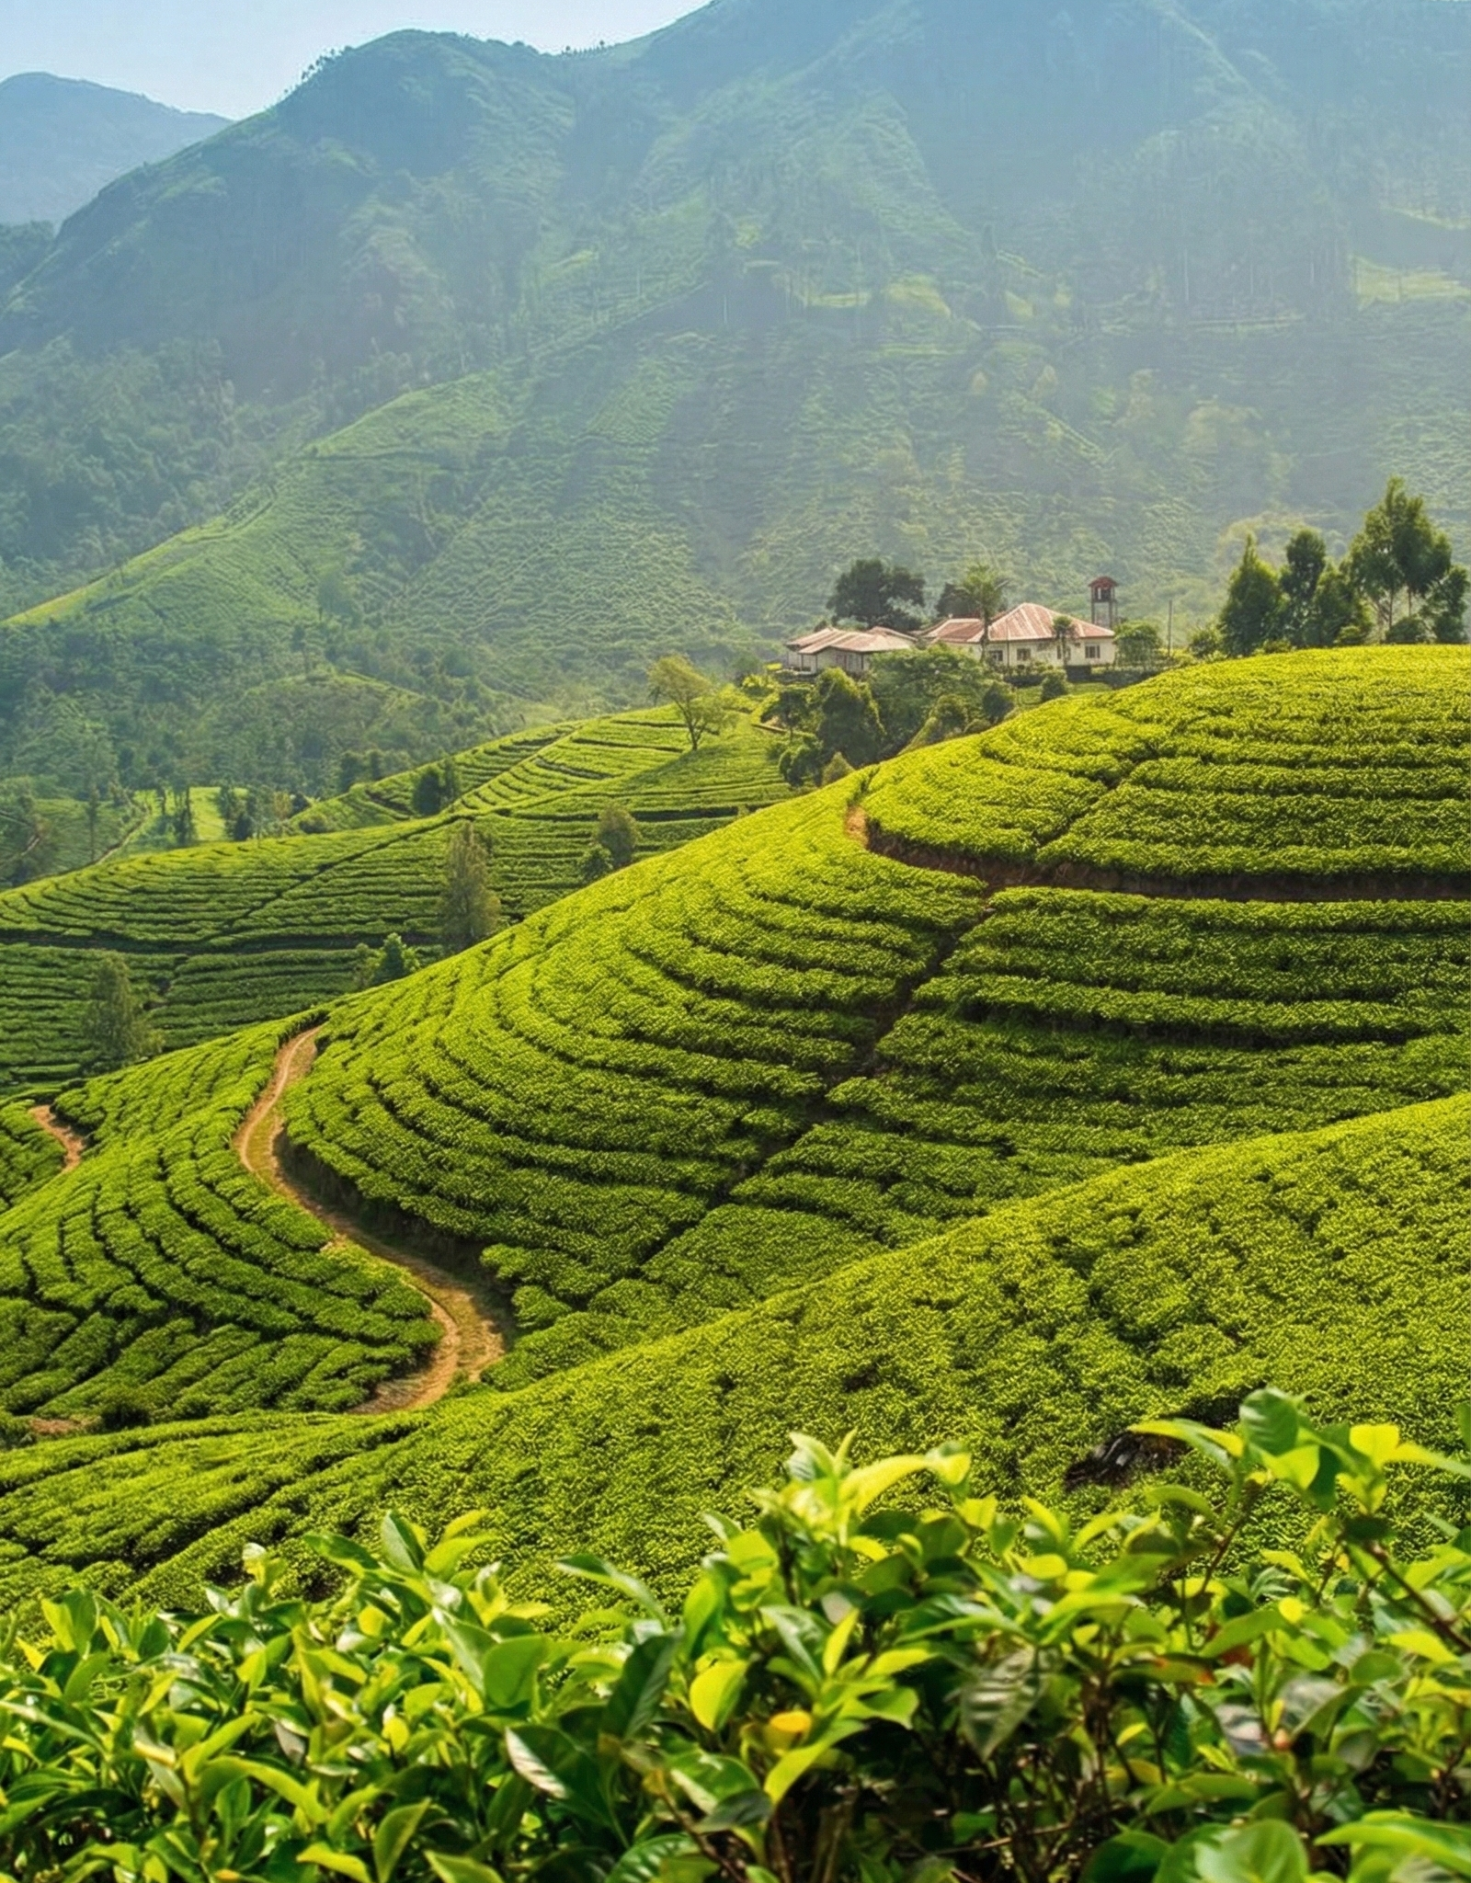
Problem Definition
Tea Price Fluctuations: Prices in the Sri Lankan tea market are unpredictable due to supply-demand imbalances.
Auction Issues: The Colombo Tea Auction struggles with oversupply or undersupply, causing price instability and financial losses.
Lack of Accurate Forecasting: Current models don’t provide factory-level insights or elevation-specific predictions that are needed for better decision-making.
B.G.W.T.N. Bandaranayake | IT22247018 | 25-26J-133
2
20
Notes:
[Sources] - https://images.unsplash.com/photo-1582016448076-551e264dd1e3 (tea leaf photo, Unsplash). [/Sources]

Slide 21
OVERVIEW
Solution: How It Addresses the Problems
1
Weekly Price Forecasting : The system will predict weekly tea prices by incorporating elevation-specific trends, historical auction data.
2
Factory-Level Volume Forecasting : The system will forecast weekly tea volumes at factory-level, ensuring that factories can better plan how much tea to send to auction, reducing the risk of oversupply or shortages.
3
Smart Auction Simulation: By simulating auction dynamics with multi-agent systems, the solution will help factories, brokers, and buyers predict price fluctuations, demand behavior, and make better auction decisions.
B.G.W.T.N. Bandaranayake | IT22247018 | 25-26J-133
21
Notes:
[Sources] - AI-generated background (no external source). [/Sources]

Slide 22
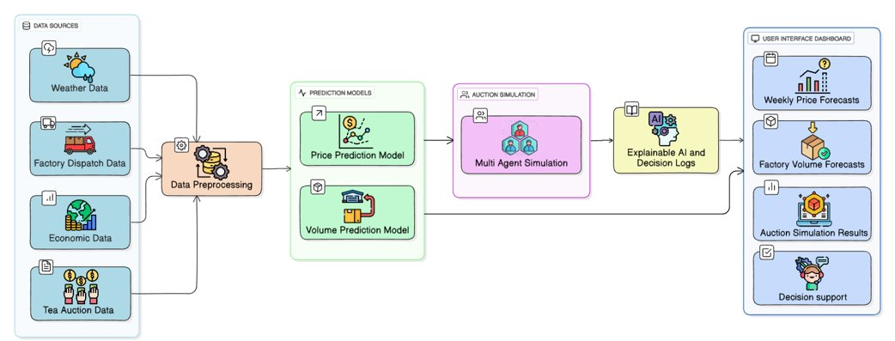
SYSTEM DIAGRAM
PROJECT ID • 25-26J-XXX
B.G.W.T.N. Bandaranayake | IT22247018 | 25-26J-133
6
22
Notes:
[Sources] - No external sources. [/Sources]

Slide 23
TECHNIQUES
Data Collection:
Time Period: Weekly data from 2023 to 2025.
Preprocessing:
Data Cleaning
Feature Engineering: Calculate total quantity , total value and average price.
Rolling Forecast: Use rolling forecasts for week-by-week price predictions, updating the
model with actual observed values.
Modeling:
Models: Use transfer learning with Arima, SARIMAX, Random Forest ,Catboost models for price and volume forecasting.
Simulation Multi-Agent Simulation:
Model auction participants (factories, brokers, buyers) using agent-based modeling (MAS) to simulate auction behaviors and decision-making.
PROJECT ID • 25-26J-XXX
B.G.W.T.N. Bandaranayake | IT22247018 | 25-26J-133
23
Notes:
[Sources] - https://images.unsplash.com/photo-1582016448076-551e264dd1e3 (tea leaf photo, Unsplash). [/Sources]

Slide 24
Technologies
Python
Scikit-learn
Time series models
Multi-Agent System (MAS)
Streamlit
DQN(Deep Q-Network )
PROJECT ID • 25-26J-XXX
B.G.W.T.N. Bandaranayake | IT22247018 | 25-26J-133
24
Notes:
[Sources] - https://images.unsplash.com/photo-1582016448076-551e264dd1e3 (tea leaf photo, Unsplash). [/Sources]

Slide 25
OVERVIEW
Current Enhancement Methods
1
Price Forecasting : Three Separate Models Created three separate price forecasting models for Low, Mid, and High-grown tea regions to provide localized price predictions.
2
Multi-Agent System (MAS) : Single-Agent Simulation: Developed a Multi-Agent System with one agent to simulate auction dynamics and provide market insights.
3
Volume Forecasting : Factory-Level Volume Predictions: Developed a volume forecasting model to predict weekly tea volumes for Mid-Country factories, optimizing production planning and auction participation.
B.G.W.T.N. Bandaranayake | IT22247018 | 25-26J-133
25
Notes:
[Sources] - AI-generated background (no external source). [/Sources]

Slide 26
OVERVIEW
Future Enhancement Methods
1. Expanded Multi-Agent System (MAS) - Multiple Agents: Extend the MAS by incorporating multiple agents to simulate interactions between factories, brokers, and buyers, improving auction decision-making and competition modeling.
2. Hybrid Price Forecasting Model- Combine Models: Integrate machine learning and time series models to combine the three separate price forecasting models for enhanced accuracy and adaptability.
3. Advanced Volume Forecasting - Enhance the volume forecasting model by integrating more data to make dynamic adjustments and improve predictions.
4. Real-Time Auction Insights-Dynamic Auction Simulation: Introduce real-time auction simulations that allow stakeholders to test market strategies and forecast auction outcomes .
B.G.W.T.N. Bandaranayake | IT22247018 | 25-26J-133
26
Notes:
[Sources] - AI-generated background (no external source). [/Sources]

Slide 27
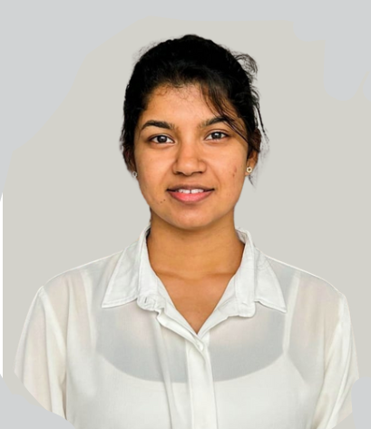
AI Based Tea Leaf Disease Detection and Treatment Guidance
WIJERATHNE H.M.K.G.D.P. - IT22142146
PROJECT ID • 25-26J-XXX
H.M.K.G.D.P. Wijerathne | IT22142146 | 25-26J-133
27
1
Notes:
[Sources] - AI-generated background (no external source). [/Sources]

Slide 28
AI Based Tea Leaf Disease Detection and
Treatment Guidance
This component detects main 6 tea leaf diseases, and 3 invasive species using CNN and R-CNN models, providing real-time
rule-based treatment guidance through a simple web interface.
End Users: Smallholder farmers, tea estate owners, researchers.
PROJECT ID • 25-26J-XXX
H.M.K.G.D.P. Wijerathne | IT22142146 | 25-26J-133
1
28
Notes:
[Sources] - AI-generated background (no external source). [/Sources]

Slide 29
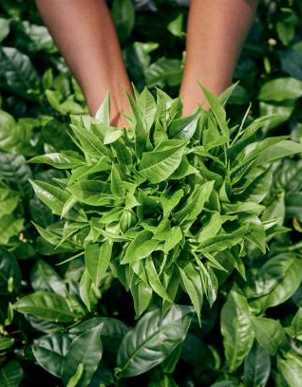
Problem Definition
Tea Crop Threats: Tea plantations face serious losses due to leaf diseases, pests, and invasive species.
Manual Detection Limitations: Existing manual inspection methods are slow, subjective, and often fail to detect problems early.
Limited Guidance: Farmers lack easy access to accurate, real-time treatment guidance, leading to improper control methods, higher costs, and environmental risks.
H.M.K.G.D.P. Wijerathne | IT22142146 | 25-26J-133
2
29
Notes:
[Sources] - https://images.unsplash.com/photo-1582016448076-551e264dd1e3 (tea leaf photo, Unsplash). [/Sources]

Slide 30
What is New in It?
Early Field-Level Identification: Enables early detection from leaf images, reducing delays caused by manual inspection and late expert intervention
Actionable Treatment Guidance: Goes beyond detection by providing practical treatment and management recommendations, including eco-friendly options
Locally Trained, Sri Lanka–Specific Models: Uses locally collected datasets from TRI and Sri Lankan tea estates, improving accuracy and real-world applicability.
Focused on Major Local Threats: Covers key diseases, pests, and emerging invasive species commonly affecting Sri Lankan tea plantations.
Unified AI-Based Detection: A single AI system that detects tea leaf diseases, pests, and invasive species, unlike existing solutions that address only one problem.
PROJECT ID • 25-26J-XXX
H.M.K.G.D.P. Wijerathne | IT22142146 | 25-26J-133
5
30
Notes:
[Sources] - AI-generated background (no external source). [/Sources]

Slide 31
Solution: How It Addresses the Problems
1
AI-Based Early Detection: Uses image-based AI models to detect tea leaf diseases, and invasive species at early stages, reducing crop damage and yield loss.
2
Single Integrated Platform: Provides a unified system that combines disease, pest, and invasive species detection instead of separate tools.
3
Practical Treatment Guidance: Offers clear, actionable treatment and management recommendations, including chemical, biological, and eco-friendly solutions.
Locally Relevant & Accurate: Trained using datasets from TRI and Sri Lankan tea estates, ensuring reliability under local field conditions.
4
3
5
Farmer-Friendly Digital Access: Accessible through a simple user interface, enabling farmers and estate managers to make quick, informed decisions.
B.G.W.T.N. Bandaranayake | IT22247018 | 25-26J-133
H.M.K.G.D.P. Wijerathne | IT22142146 | 25-26J-133
24
31
Notes:
[Sources] - AI-generated background (no external source). [/Sources]

Slide 32
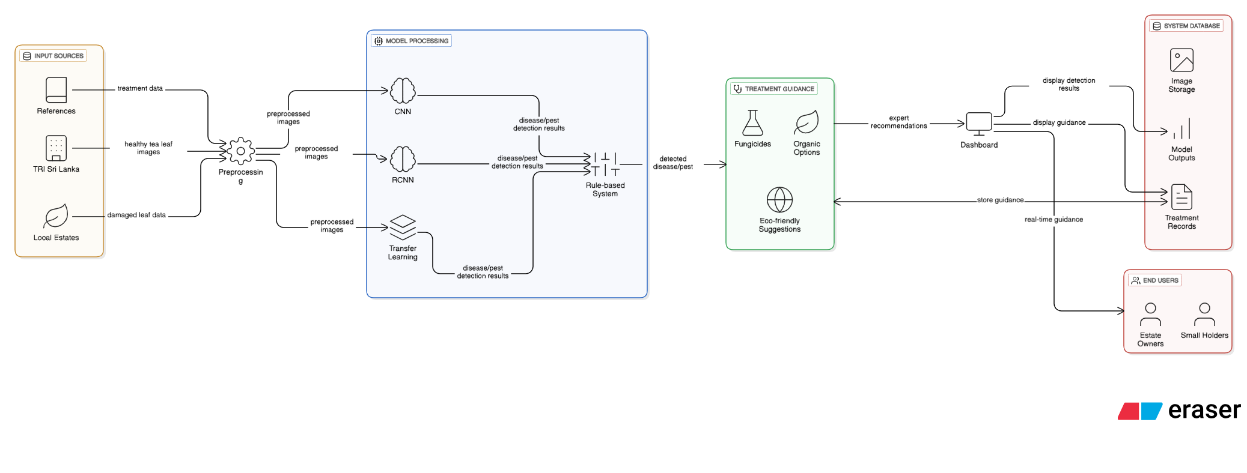
SYSTEM DIAGRAM
PROJECT ID • 25-26J-XXX
H.M.K.G.D.P. Wijerathne | IT22142146 | 25-26J-133
32
3
Notes:
[Sources] - AI-generated background (no external source). [/Sources]

Slide 33
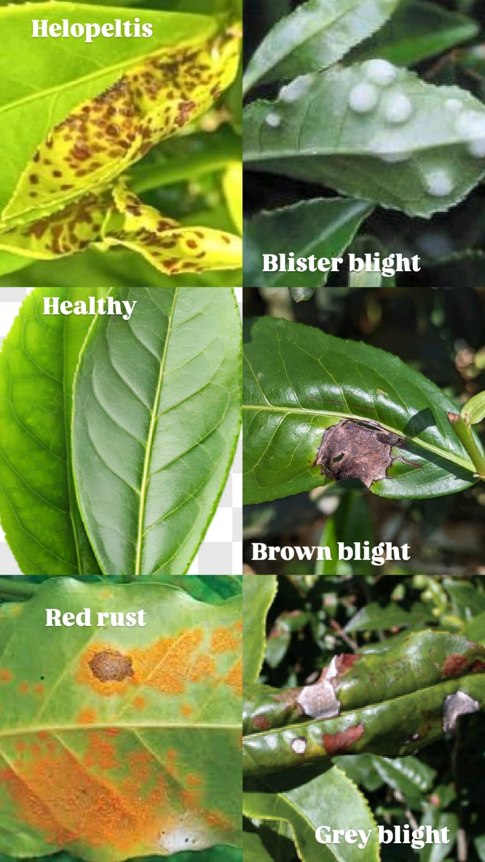
TECHNIQUES
Helopeltis
Red Rust
Healthy
Data Collection:
Disease Classes:
Blister Blight
Brown Blight
Grey Blight
Data Type: High-resolution RGB images under natural and controlled lighting conditions.
Dataset Size: 6,000+ annotated images covering 6 diseases.
Invasive Species Classes:
Lantana Camara
Tridax Procumbens
Vernonia Cinerea
Preprocessing:
Image Resizing & Cleaning, Normalization: Rescale pixel values for better model convergence.
Data Augmentation: Random flips, rotation, brightness adjustments to improve robustness.
Dataset Splitting
PROJECT ID • 25-26J-XXX
B.G.W.T.N. Bandaranayake | IT22247018 | 25-26J-133
H.M.K.G.D.P. Wijerathne | IT22142146 | 25-26J-133
24
33
Notes:
[Sources] - https://images.unsplash.com/photo-1582016448076-551e264dd1e3 (tea leaf photo, Unsplash). [/Sources]

Slide 34
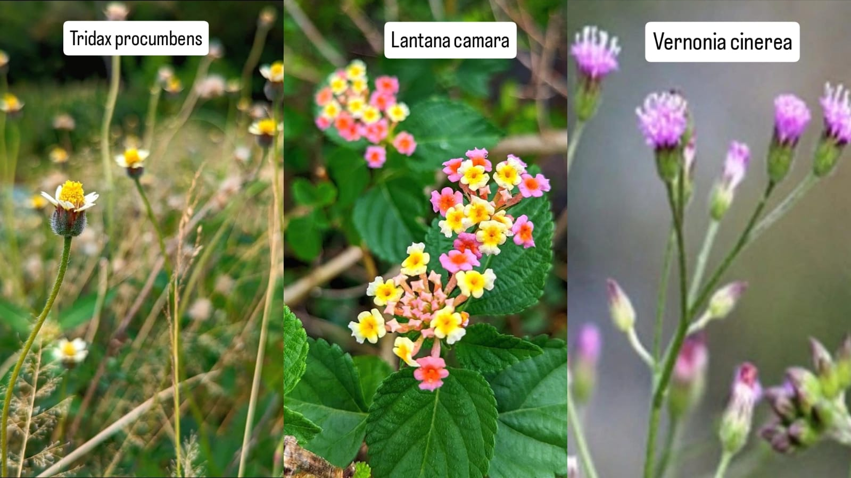
Modeling:
Model Type: CNN, R-CNN and YOLOv2 models. Confusion Matrix used for class-wise analysis. High precision and recall across all disease categories.
Functionality: Detects diseases and invasive species; classifies leaf condition.
Optimization: Adam optimizer with categorical cross-entropy loss.
Model Selection: Best-performing model chosen based on validation accuracy
Treatment Recommendation Guidance​:
Approach: Expert-defined rules based on type, severity, and symptoms.​
Purpose: Provide practical, both eco-friendly treatment and chemical treatment recommendations.​
Technologies
Python
TensorFlow & Keras
NumPy & Matplotlib
Image classification models
Streamlit
VS Code / Anaconda
Rule Based System
PROJECT ID • 25-26J-XXX
H.M.K.G.D.P. Wijerathne | IT22142146 | 25-26J-133
34
Notes:
[Sources] - https://images.unsplash.com/photo-1582016448076-551e264dd1e3 (tea leaf photo, Unsplash). [/Sources]

Slide 35
OVERVIEW
Current Enhancement Methods
Dataset Collection: Collected tea leaf images from local tea estates and verified reference sources to ensure real-world relevance.​ ​
Model Training & Comparison: Trained and evaluated CNN, R-CNN, and YOLOv2 models to compare performance and select the most suitable model.​ ​
Disease Detection: Accurately detected six major tea leaf diseases with approximately 94% accuracy and presented results through a user-friendly interface.​ ​
Treatment Recommendation System: Developed a recommendation system to suggest both organic and chemical treatments based on disease severity and symptoms.​ ​
User Interface Development: Built an interactive web-based frontend to allow easy image upload, form-based inputs, and clear result visualization.
H.M.K.G.D.P. Wijerathne | IT22142146 | 25-26J-133
35
Notes:
[Sources] - AI-generated background (no external source). [/Sources]

Slide 36
OVERVIEW
Future Enhancement Methods
Invasive Species Detection: Extend the CNN-based model to identify invasive species and additional pest threats affecting tea plants.
Treatment System Completion: Fully implement and validate the treatment recommendation system with expert-verified organic and chemical solutions.
Mobile Application Development: Develop a mobile application using TensorFlow Lite to enable on-device disease detection for field-level usage.
Real-World Deployment & Commercialization: Optimize the system for large-scale deployment and prepare it for commercial use by tea estates and agricultural authorities.
H.M.K.G.D.P. Wijerathne | IT22142146 | 25-26J-133
35
Notes:
[Sources] - AI-generated background (no external source). [/Sources]

Slide 37
OVERVIEW
COMMERCIALIZATION
The overall commercialization plan will emphasize accessibility, affordability, and scalability. Each component will be marketed through a subscription model, with tiered pricing options based on the size of the enterprise or tea estate. Industry partnerships will be central to building credibility, while digital marketing and industry events will help increase awareness. Over time, the goal is for the system to establish itself as a core decision-support tool for the Sri Lankan tea industry, with plans to expand regionally. The system’s development will be guided by user feedback, ensuring continued improvements to meet the evolving needs of the market.
25-26J-133
36
Notes:
[Sources] - AI-generated background (no external source). [/Sources]

Slide 38

BUDGET & RESOURCES
Item
Monthly Cost
Justification
GPU/Colab/Cloud
LKR 6000
Training + evaluation
Data Storage
LKR 10000
Cloud
Transporting
LKR 15000
Data collection
PROJECT ID • 25-26J-XXX
25-26J-133
9
37
Notes:
[Sources] - https://images.unsplash.com/photo-1498604636225-6b87a314baa0 (tea cup photo, Unsplash). [/Sources]

Slide 39
THANK YOU
PROJECT ID • 25-26J-XXX
25-26J-133
10
38
Notes:
[Sources] - AI-generated background (no external source). [/Sources]

